Slide 1
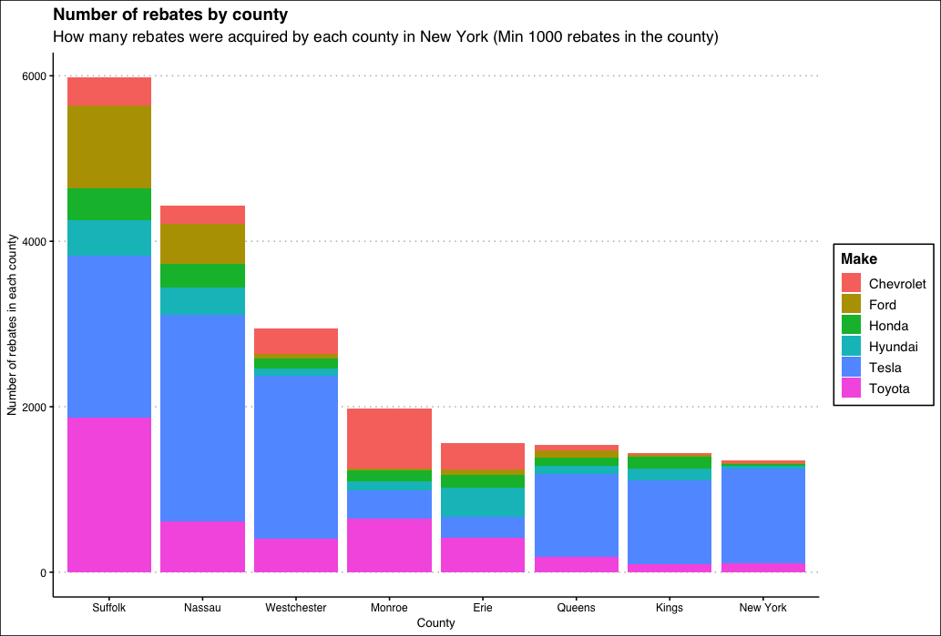
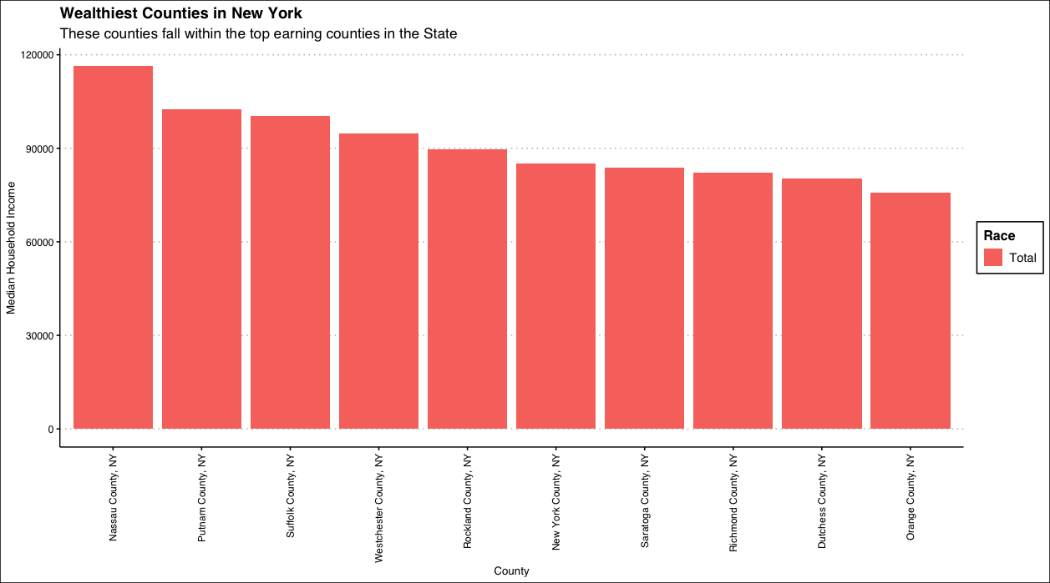
So firstly where are electric cars being bought from?
The wealthiest counties are taking advantage of the scheme, many of which with median incomes exceeding $80k, so it is safe to assume that it mainly benefitting people with incomes exceeding $100k

Slide 2
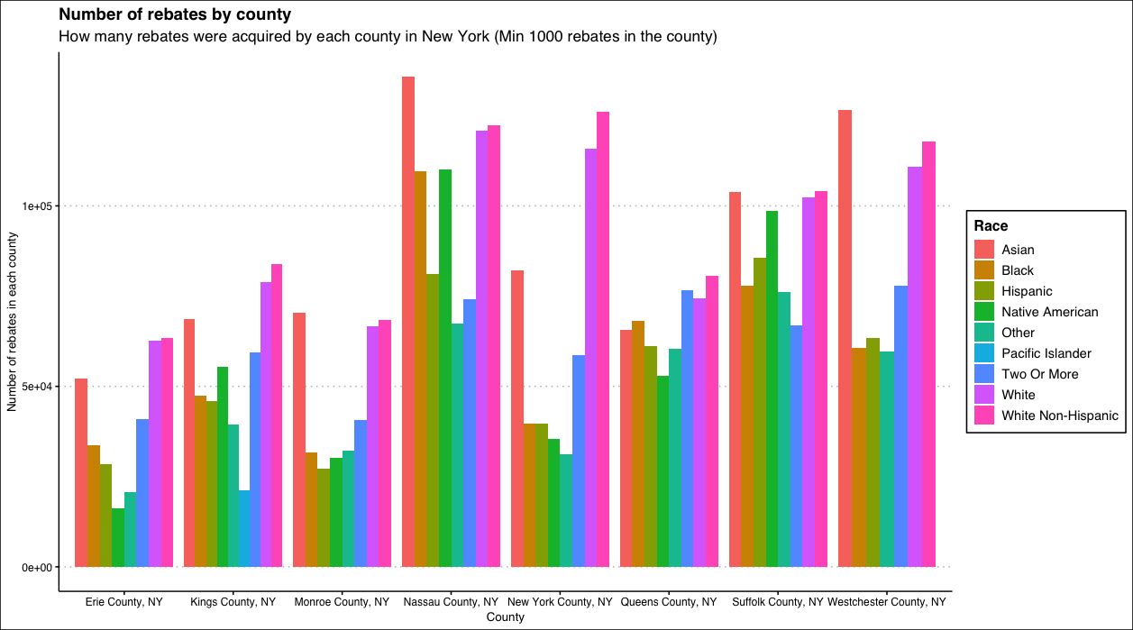
We can see white people are amongst the Highest earners in these counties but also the evidence shows that Asians may also be benefitting from the scheme too

Slide 3
Gender

